Slide 1
Early Phase Need Analysis
-Can We Ease Systems Integration?
Kongsberg 14.06.2013
Eldar Tranøy | Systems Engineer

Slide 2
Agenda
Introduction
Motivation For Research
Systems Engineering – How to do it
Aker Solutions – How are we doing it
Need analysis
Summary and Conclusion

Slide 3
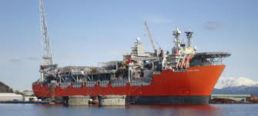
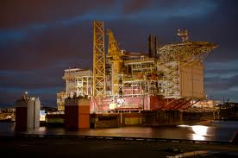
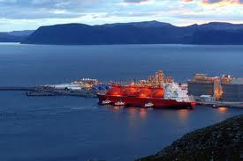
Motivation For Research
Large cost overruns on EPC projects on the Norwegian continental shelf
  Skarv
  Snøhvit LNG
  Yme
10 large EPC projects totaled a 96 Bn NoK cost overrun
Large media exposure and highlighted in the Norwegian national budget

Slide 4
Motivation For Research
Cost overruns on EPC projects is not a new phenomenon
The investment Committees report – «Analysis of the development of investments on the Norwegian continental shelf»
  Government initiated report released in 1999
  Documents cost overruns similar to media reported cost overruns for 2004- 2008
Consistent trend with cost overruns from 1994 through 2008

Slide 5
Planned vs Actual Cost - BNoK

Slide 6
Motivation for research - Cost To Society
Strong tax incentives for oil companies to invest on the Norwegian Continental Shelf
78% of the investment cost is tax reimbursable
This also applies to the cost overruns
Total amount of cost overruns:
  1994-1998: 4 Billion Euros (documented)
  1998-2008: 13 Billion Euros (estimated)
Continuous and increased media focus expected.

Slide 7

$$\text{“}\text{In} \text{reality}\text{, }\text{The} \text{Norwegian} \text{government} \text{covers}\text{ 93\% }\text{of} \text{the} \text{cost} \text{overruns}\text{”}$$
K.I. Røkke in his letter to the shareholders

Slide 8
Main Cost Drivers
Project | Estimated cost | Actual / New estimate | Change | Change in %
Balder | 5 | 8,08 | 3,08 | 62
Gullfaks Sat 1 | 6,86 | 9 | 2,14 | 31
Jotun | 6,2 | 7,2 | 1 | 16
Njord | 6,31 | 7,76 | 1,45 | 23
Norne | 8,62 | 9,27 | 0,65 | 8
Oseberg Sør | 8,05 | 8,75 | 0,7 | 9
Oseberg Øst | 3,49 | 4,3 | 0,81 | 23
Troll Gass | 18,25 | 20,77 | 2,52 | 14
Varg | 2,94 | 3,64 | 0,7 | 24
Visund | 7,85 | 11,4 | 3,55 | 45
Åsgard | 28,52 | 37 | 8,48 | 30
Kårstø | 2,94 | 7,08 | 4,14 | 141
Åsgard Transport | 7,36 | 7,96 | 0,6 | 8
Snøhvit LNG | 43,8 | 64,5 | 20,7 | 47
Ormen Lange | 72,5 | 107,1 | 34,6 | 48
Alvheim | 8,7 | 17,2 | 8,5 | 98
Statfjord Seinfase | 14,5 | 18,5 | 4 | 28
Blane | 1,8 | 3,5 | 1,7 | 94
Valhall Re-dev | 23,7 | 39,9 | 16,2 | 68
Gjøa (ink gaspipe) | 30,2 | 34,7 | 4,5 | 15
Yme | 4,7 | 8 | 3,3 | 70
Skarv | 34,3 | 35,8 | 1,5 | 4
Vega + Vega Sør | 6,4 | 7,5 | 1,1 | 17
Numbers from the investment committee's report are all calculated as value pr. 1998
Scope changes and late design changes are considered to be the main drivers
  Has potential to add schedule delay
Imposes a project risk
  Oil companies need means to mitigate these risks
The risk is transferred to the contractors
Methods and tools to reduce the amount of late design changes might yield a competitive advantage

Slide 9
Systems Engineering
SE have proven valuable to reduce the amount of scope changes and late design changes
We therefore initially assumed that using SE would prove effective, and help reduce scope changes and late design changes.
The Oil&Gas (O&G) industry is already using SE
Despite the use of SE, O&G EPC projects continue to see large cost overruns
Why?
Notes:
SE is already a part of industrial standards and is written into contracts as a requirement for the work to be done

Slide 10
Systems Engineering - Benchmarking
Systems Engineering Body of Knowledge (SEBoK)
Fundamental SE process:

Slide 11
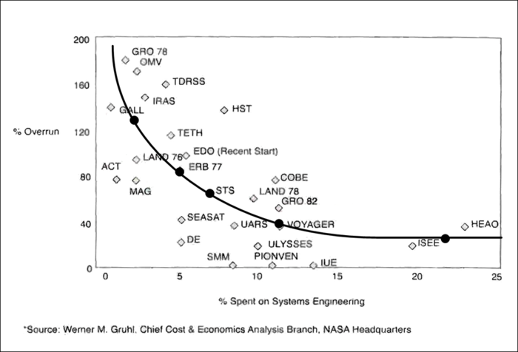
Systems Engineering – Benchmarking
Eric Honour (2004) – Value of Systems engineering
Gruhl (1992) – NASA research
  Less cost overruns with early phase effort
Barker (2003) – IBM research
  Productivity improvement, cost savings and increased quality of design
Notes:
For Systems Engineering to work, it needs to be performed correctly and at the correct time.

Slide 12
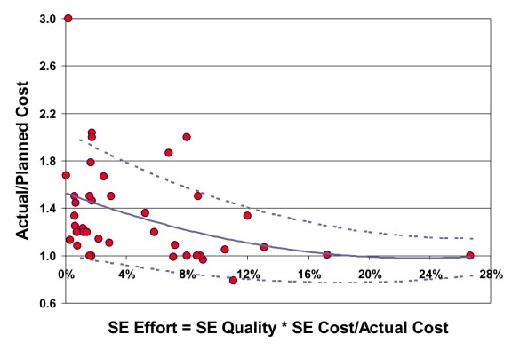
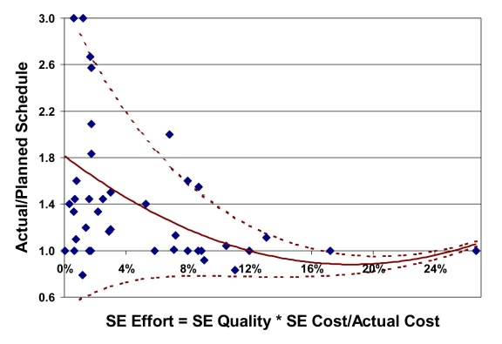
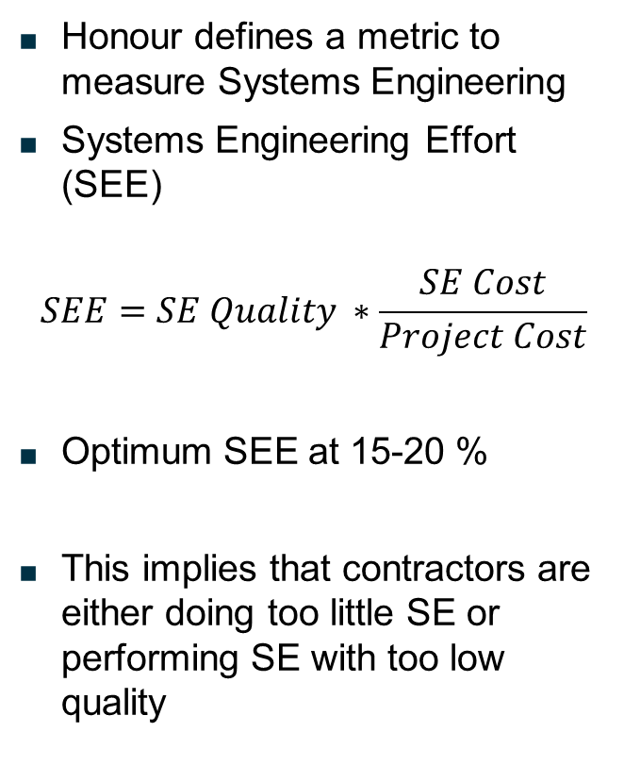
Systems Engineering - Benchmarking
Honour defines a metric to measure Systems Engineering
Systems Engineering Effort (SEE)
$$SEE=SE Quality ∗\frac{SE Cost}{Project Cost}$$
Optimum SEE at 15-20 %
This implies that contractors are either doing too little SE or performing SE with too low quality
Notes:
This indicates that a projects cost and schedule is dependent not only on the timing of the Systems Engineering, but also the quality and the amount of systems engineering which is being done

Slide 13
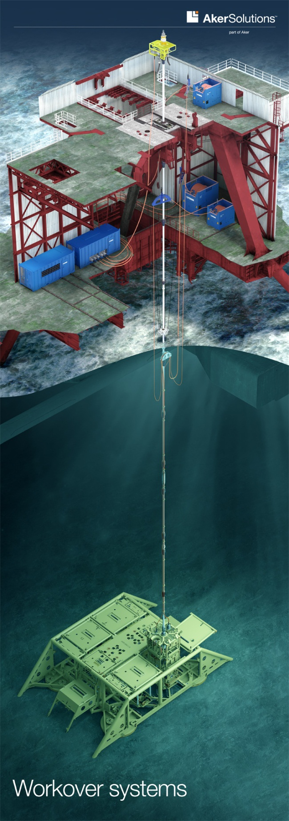
Example Project – Vigdis NE WOS
Workover Systems / Light Well Intervention Equipment
System delivery comprise of:
  EDP/LRP
  Riser System
  multiWOCS
Interfaces XMTs/Wells from multiple vendors
Interfaces multiple offshore vessels / rigs
Follows the “FastTrack” delivery scheme

Slide 14
Identifying Root Causes
We needed to benchmark SE performance in Vigdis NE WOS
Amount of SE:
  8,5% of total project cost
  Too low for optimum SEE
  High enough to expect good results
Startup of SE activities:
  Initiated at project startup
  Confirmed by project timeline
Performed a comparison of internal SE activities compared to SE fundamental processes
Notes:
SE activities as described in SEBoK

Slide 15
Capturing the Customer Perspective
Assess if the initial system design covered the operational need of the customer
Establish a basis to evaluate the initial need analysis done in the project
Performed through in-depth interview with customers’ technical lead
Three main root causes were identified

Slide 16
Capturing the Customer Perspective
Cross vendor interfaces
  Not evaluated in the research
Mismatch between tendered design and operational needs
  Requirements derived from the tender phase were generic, not application specific
  Leads to over-dimensioning of subsystems
Mismatch between requirements in governing documents and operational needs and physical limitations of interfacing systems and stakeholders
  The needs of the operational vessels not covered by governing documents
  This will in turn affect how the requirements interact
  Governing documents define the system and impose weight restrictions
  These restrictions exceed the lifting capacity of the operational vessels

Slide 17
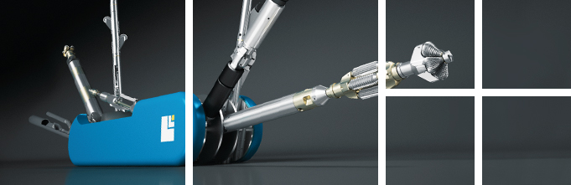
Capturing the Customer Perspective
This effectively means that the design that won the tender is not suitable for the actual operational needs of the customer

Slide 18
Aker Solutions – Are we doing it right?
In-depth interview revealed that the projects SE processes had been unsuccessful in capturing the customers’ operational needs
SEBoK states that:
  SE shall perform the initial capturing of needs before system design
  Derive system requirements from the needs
Are our internal procedures in accordance with SEBoK?

Slide 19
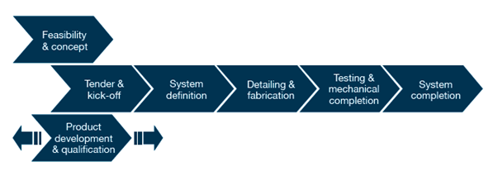
Aker Solutions – Are we doing it right?
PEM
High level model which governs the overall processes in all AkSo projects
The PEM defines how to systematically move from a concept, to win a tender and how to execute a complete project
Does the PEM model cause limitations in SE Effort?

Slide 20
Aker Solutions – Tender Phase
How does the tender phase define a system and it’s requirements?
  No need analysis
  No requirements definition
This is due to the tender process being a public process.
  This implies that all communication towards company is in principle public communication.
  Little or no communication takes place during the tender, due to the risk of SE efforts being revealed to competitors
As earlier described, this results in tendered system design being different from the system design the customer actually needs
This finding is supported by the investment committee’s report
  The report also address the problem with little to no communication during the tender and the subsequent consequences of the current tendering regime

Slide 21
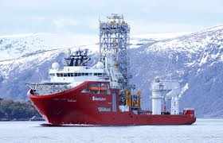
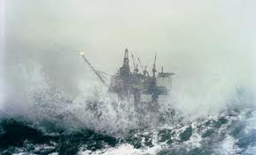
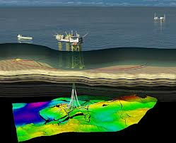
Aker Solutions – Tender Phase
When contractors enter into a tender, it is not unusual that essential operational data is missing.
This finding also correlates with the investment committee’s report
Examples of typical missing data:
  Meteorological and oceanographic data
  Field data
  Soil data
  Fluid data
  Installation vessel data
Notes:
This is a very important finding

Slide 22
Aker Solutions – F&C
F&C offers more degrees of freedom for design
No single concept is chosen at startup
Both contractor and customer has the freedom to tailor the design
Communication between participants are more open
  This allows for more customer interaction and identification of underlying needs
AkSo assumes that the generic customer requirements are sufficient
Requirements definition activity exists
No need analysis takes place
Notes:
Since neither project execution nor tendering does need analysis and requirements definition, can F&C contribute?

Slide 23
Potential Impact of Need Analysis During F&C
The research into the tender procedures revealed that tenders often are clearly influenced by the company performing the initial study
A contractor that uses need analysis during the F&C phase will have the opportunity to tailor the study to the customer needs, and adapt it to the contractors available technology
If need analysis is used during F&C to identify needs not stated in the customers F&C documentation or ITT, the contractor can potentially gain a competitive advantage to win the contract and execute the work with less design changes
Less design changes will increase the profitability potential of the project and gives the customer a more predictable project cost

Slide 24
Analysis of Cost and Potential Impact
Analysis of VO registry
  Changes to design or scope normally results in a variation order (VO)
  Cost of change is normally carried by customer
  Review of 23 VO’s
Findings
  74% of the VO’s were preventable by need analysis
  92% of the cost incurred by late design changes, were preventable
Root cause analysis of the preventable VO’s
  Changes to product design
  Mismatches between project requirements and operational needs

Slide 25
Recommended Process Change
Notes:
We have established a lack of a process activity to capture customer needs in the internal procedures of AkSo, and we suggest need analysis as a suitable tool

Slide 26
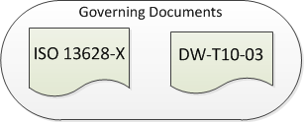
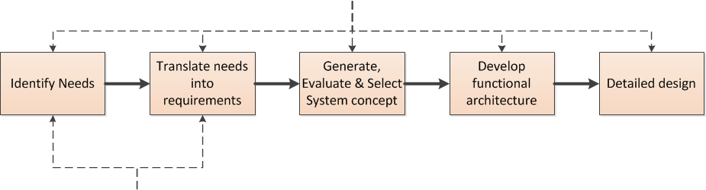
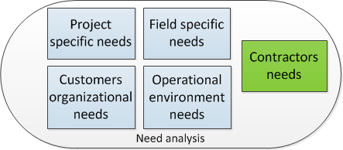
Recommended Process Change

Slide 27
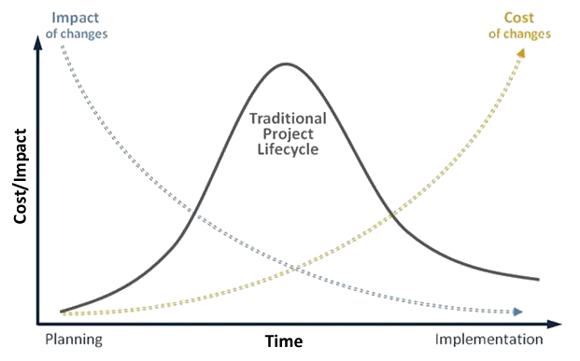
From Needs To Systems Integration

Slide 28
From Needs To Systems Integration
Stakeholder Needs
User
Requirements
System Validation
System Requirements
System Verification
Architecture
Definition
System Integration
High-level Design
Unit Test
Detailed Design

Slide 29
Summary
The research shows strong incentives for contractors to use structured need analysis
Using structured need analysis can help contractors to:
  Deliver more tailored solutions to each customer
  Avoid costly late design changes and schedule delays
  Less late design changes contributes to smoother systems integration and increases both actual and perceived quality

Slide 30
Academic Background for the Reasearch
Industry Documents
ISO 13628-X
DW-T10-03
AkSo PEM
Contract – Vigdis NØ C/WO
Vigdis NØ VO registry
Independent Research
Systems Engineering Body of Knowledge
Eric Honour – «understanding the value of systems engineering»
The investment committee – «Analysis of the development of investments on the Norwegian continental shelf»

Slide 31
Copyright and disclaimer
Copyright
Copyright of all published material including photographs, drawings and images in this document remains vested in Aker Solutions and third party contributors as appropriate. Accordingly, neither the whole nor any part of this document shall be reproduced in any form nor used in any manner without express prior permission and applicable acknowledgements. No trademark, copyright or other notice shall be altered or removed from any reproduction.
Disclaimer
This Presentation includes and is based, inter alia, on forward-looking information and statements that are subject to risks and uncertainties that could cause actual results to differ. These statements and this Presentation are based on current expectations, estimates and projections about global economic conditions, the economic conditions of the regions and industries that are major markets for Aker Solutions ASA and Aker Solutions ASA’s (including subsidiaries and affiliates) lines of business. These expectations, estimates and projections are generally identifiable by statements containing words such as “expects”, “believes”, “estimates” or similar expressions. Important factors that could cause actual results to differ materially from those expectations include, among others, economic and market conditions in the geographic areas and industries that are or will be major markets for Aker Solutions’ businesses, oil prices, market acceptance of new products and services, changes in governmental regulations, interest rates, fluctuations in currency exchange rates and such other factors as may be discussed from time to time in the Presentation. Although Aker Solutions ASA believes that its expectations and the Presentation are based upon reasonable assumptions, it can give no assurance that those expectations will be achieved or that the actual results will be as set out in the Presentation. Aker Solutions ASA is making no representation or warranty, expressed or implied, as to the accuracy, reliability or completeness of the Presentation, and neither Aker Solutions ASA nor any of its directors, officers or employees will have any liability to you or any other persons resulting from your use.
Aker Solutions consists of many legally independent entities, constituting their own separate identities. Aker Solutions is used as the common brand or trade mark for most of these entities. In this presentation we may sometimes use “Aker Solutions”, “we” or “us” when we refer to Aker Solutions companies in general or where no useful purpose is served by identifying any particular Aker Solutions company.

